Slide 1
THE LORD’S PRAYER Our Father, who art in heaven, hallowed be thy name; thy kingdom come; thy will be done; on earth as it is in heaven. Give us this day our daily bread. And forgive us our trespasses,

Slide 2
as we forgive those who trespass against us. And lead us not into temptation; but deliver us from evil. For thine is the kingdom, the power and the glory, for ever and ever. Amen.

Slide 4
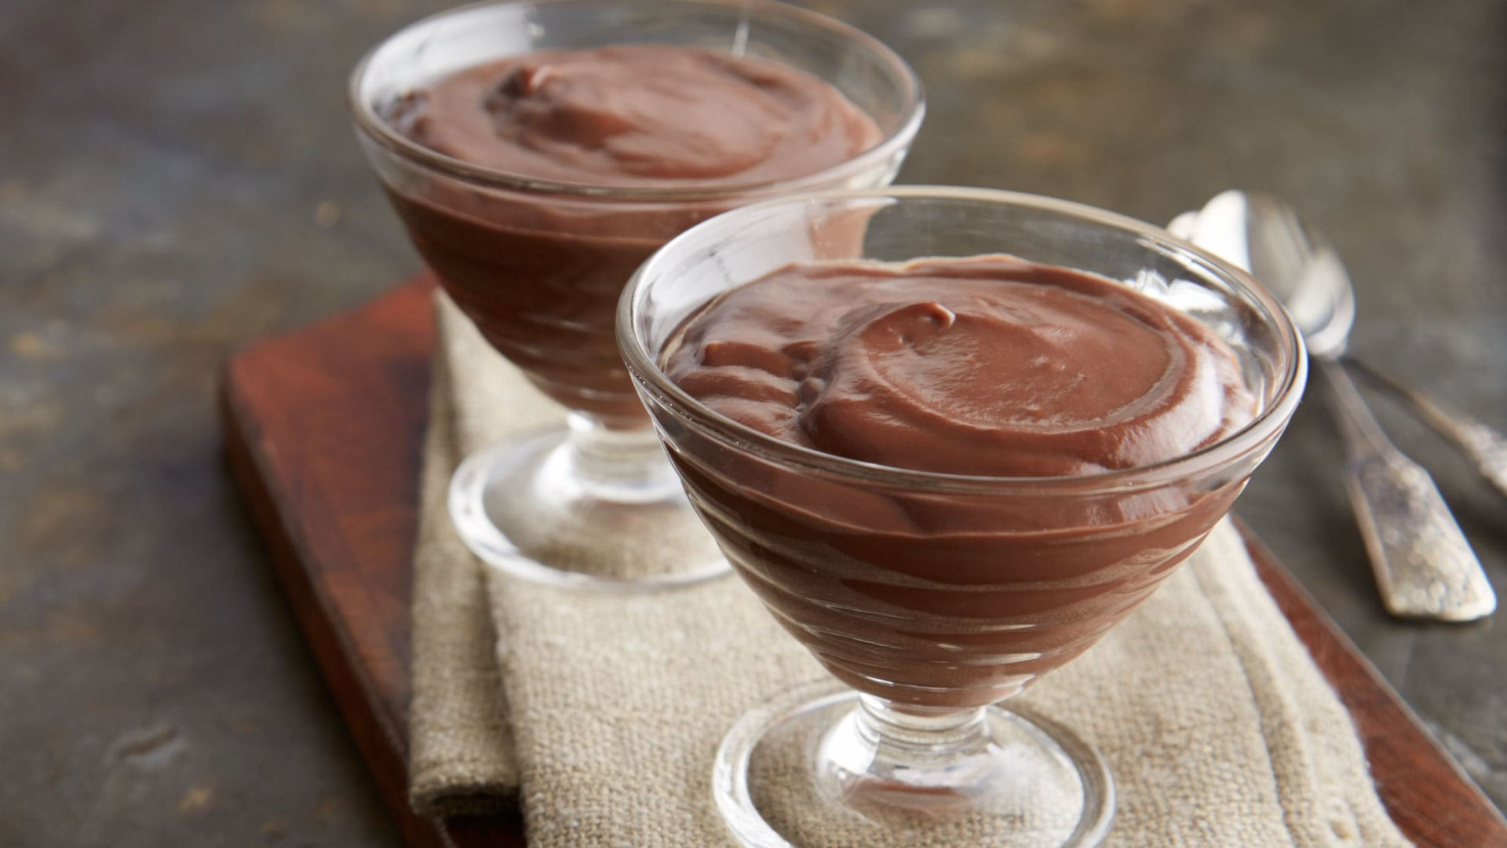
THE PROOF IS IN THE…

Slide 5
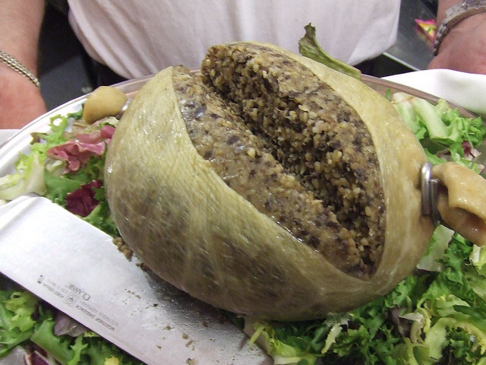
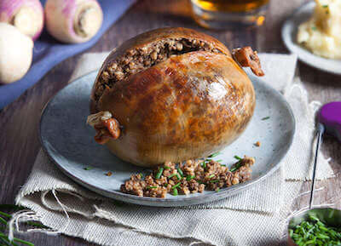

Slide 6
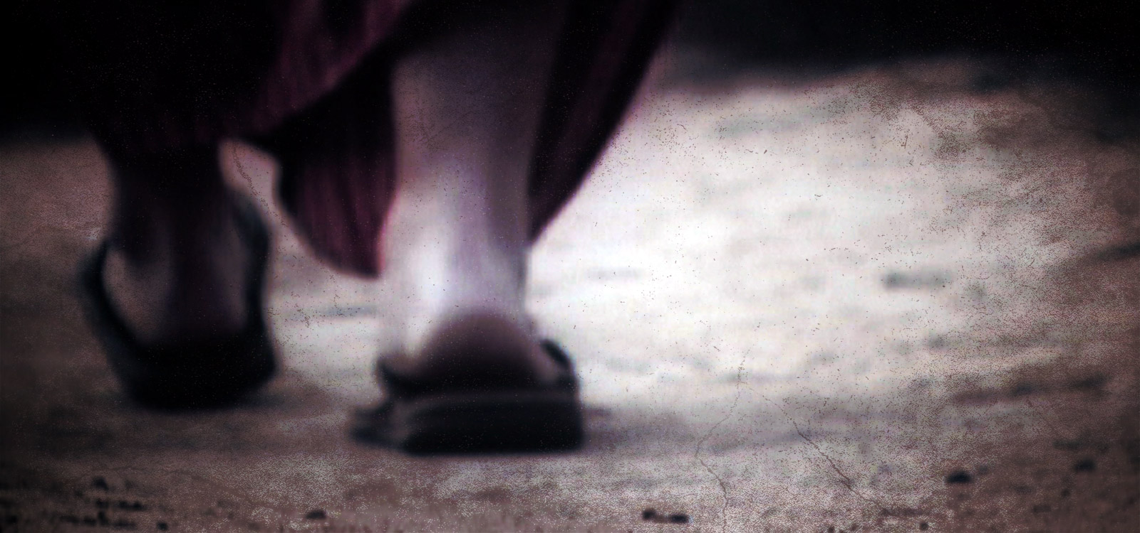
Signs of a True Follower of Jesus Christ

Slide 7
1 Thessalonians 1:4-5
For we know, brothers loved by God, that he has chosen you, ⁵ because our gospel came to you not only in word, but also in power and in the Holy Spirit and with full conviction

Slide 8
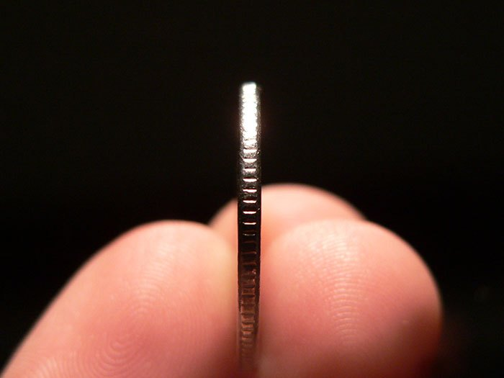
Evidences of Salvation in the Lives of People
GOD’S WORK

Slide 9
Evidences of Salvation in the Lives of People
GOD’S WORK
God loves

Slide 10
Evidences of Salvation in the Lives of People
GOD’S WORK
God loves
God chooses

Slide 11
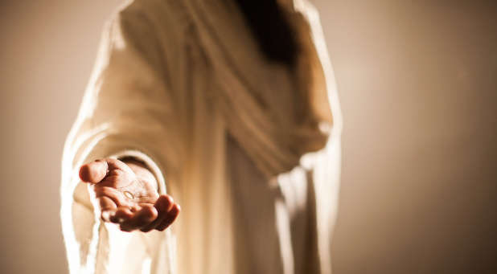

Slide 12
1 Thessalonians 1:5
“…because our gospel came to you not only in word, but also in power and in the Holy Spirit and with full conviction.”
1. The truth/word of the Gospel settles in.
2. The power of God impacts us.
3. The life of the Holy Spirit affects us.
4. The conviction/assurance of our soul changes.

Slide 13
Evidences of Salvation in the Lives of People
GOD’S WORK
1. His word

Slide 14
Evidences of Salvation in the Lives of People
GOD’S WORK
1. His word
2. His power

Slide 15
Evidences of Salvation in the Lives of People
GOD’S WORK
1. His word
2. His power
3. His Holy Spirit

Slide 16
Evidences of Salvation in the Lives of People
GOD’S WORK
1. His word
2. His power
3. His Holy Spirit
4. His assurance

Slide 17
1 Thessalonians 1:5-6
“You know what kind of men we proved to be among you for your sake. ⁶ And you became imitators of us and of the Lord….”

Slide 18
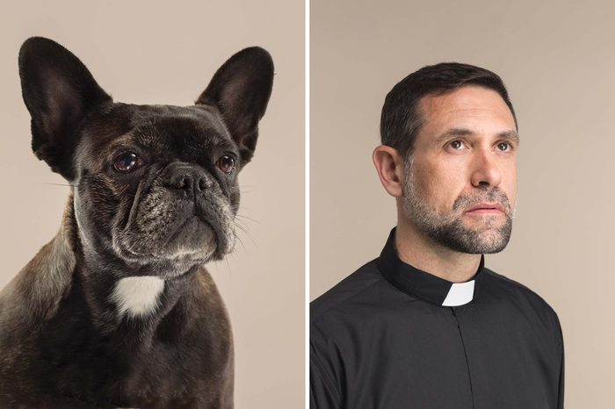

Slide 20
1 Thessalonians 1:6
“And you became imitators of us and of the Lord, for you received the word in much affliction, with the joy of the Holy Spirit.…”

Slide 21
Evidences of Salvation in the Lives of People
GOD’S WORK
OUR WORKS
“And you became imitators of us and of the Lord, for you received the word in much affliction, with the joy of the Holy Spirit.…”
1 Thess. 1:6
1. Joy in the Word

Slide 22
1 Thessalonians 1:7-8
”…so that you became an example to all the believers in Macedonia and in Achaia. ⁸ For not only has the word of the Lord sounded forth from you in Macedonia and Achaia, but your faith in God has gone forth everywhere, so that we need not say anything.”

Slide 23
Evidences of Salvation in the Lives of People
GOD’S WORK
OUR WORKS
“…the word of the Lord sounded forth from you….”
1 Thess. 1:8
Joy in the Word
Expanding witness

Slide 24
1 Thessalonians 1:9-10
For they themselves report concerning us the kind of reception we had among you, and how you turned to God from idols to serve the living and true God, ¹⁰ and to wait for his Son from heaven, whom he raised from the dead, Jesus who delivers us from the wrath to come.

Slide 25
Evidences of Salvation in the Lives of People
GOD’S WORK
OUR WORKS
“And you became imitators of us and of the Lord, for you received the word in much affliction, with the joy of the Holy Spirit.…”
1 Thess. 1:6
3. Replacing competing gods with God alone.

Slide 26
1 Thessalonians 1:9-10
For they themselves report concerning us the kind of reception we had among you, and how you turned to God from idols to serve the living and true God, ¹⁰ and to wait for his Son from heaven, whom he raised from the dead, Jesus who delivers us from the wrath to come.

Slide 27
Evidences of Salvation in the Lives of People
GOD’S WORK
OUR WORKS
1. His word
2. His power
3. His Holy Spirit
4. His assurance
3. Replacing competing gods with God-serving
4. Longing to serve God

Slide 28
Evidences of Salvation in the Lives of People
GOD’S WORK
OUR WORKS
1. His word
2. His power
3. His Holy Spirit
4. His assurance
Joy in the Word
Expanding witness
Replacing compet-ing gods with God alone
Longing to serve God

