Slide 1
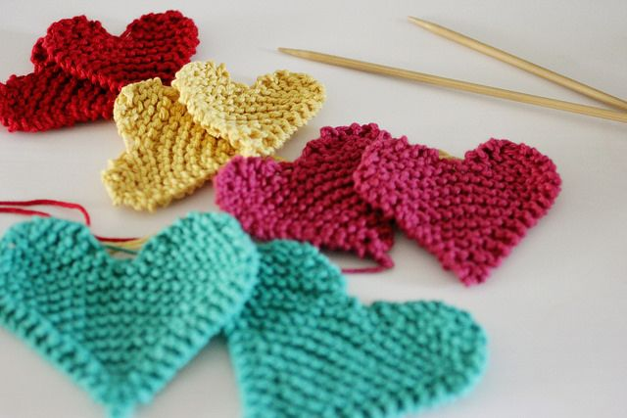
Knitting Hearts Together Romans 16

Slide 2
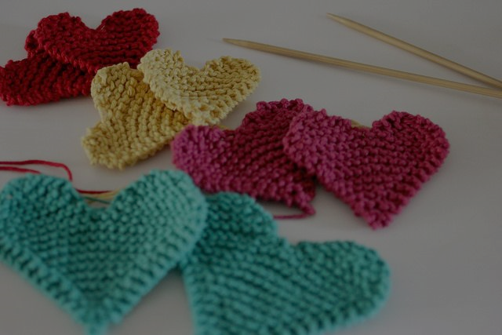
1.) We each have different capacities for friendship.

Slide 3
WE KNIT OUR HEARTS TOGETHER AS WE… 2.) Serve others and engage in ministry together. (vss. 1, 2, 3, 6, 9, 12)

Slide 4
³ Greet Priscilla and Aquila, my co-workers in Christ Jesus.
⁷ Greet Andronicus and Junia, my fellow Jews who have been in prison with me. They are outstanding among the apostles, and they were in Christ before I was.
⁹ Greet Urbanus, our co-worker in Christ
¹² Greet Tryphena and Tryphosa, those women who work hard in the Lord.
Greet my dear friend Persis, another woman who has worked very hard in the Lord.
²¹ Timothy, my co-worker, sends his greetings to you

Slide 5
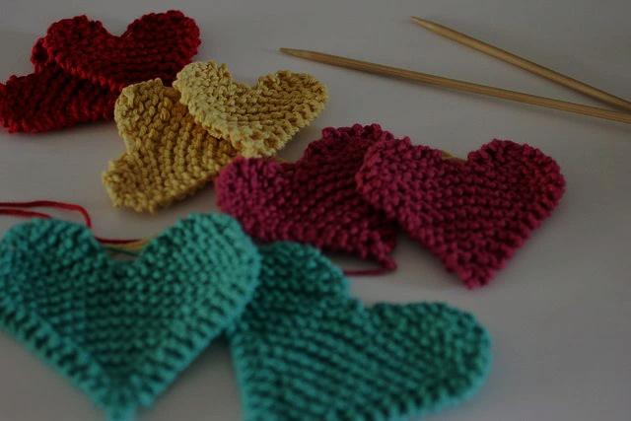
WE KNIT OUR HEARTS TOGETHER AS WE… 3.) GREET ONE ANOTHER SINCERELY & APPROPRIATELY ¹⁶ Greet one another with a holy kiss.

Slide 6
WE KNIT OUR HEARTS TOGETHER AS WE…4.) Spend time weekly and regularly with an oikos of believers. ⁵ Greet also the church that meets at their house.

Slide 7
WE KNIT OUR HEARTS TOGETHER AS WE…5.) lead others to Jesus. ⁵ Greet my dear friend Epenetus, who was the first convert to Christ in the province of Asia.

Slide 8
WE KNIT OUR HEARTS TOGETHER AS WE…6.) overcome cultural barriers and prejudices.

Slide 9
WE KNIT OUR HEARTS TOGETHER AS WE…7.) share suffering together. ⁷ Greet Andronicus and Junia, my fellow Jews who have been in prison with me. They are outstanding among the apostles, and they were in Christ before I was.

Slide 10
WE KNIT OUR HEARTS TOGETHER AS WE…8.) stand the test over time together. ¹⁰ Greet Apelles, whose fidelity to Christ has stood the test.

Slide 11
WE KNIT OUR HEARTS TOGETHER AS WE…9.) are generous and gracious with our praise of each other.

Slide 12
ROMANS 16:17-19
¹⁷ I urge you, brothers and sisters, to watch out for those who cause divisions and put obstacles in your way that are contrary to the teaching you have learned. Keep away from them. ¹⁸ For such people are not serving our Lord Christ, but their own appetites. By smooth talk and flattery they deceive the minds of naive people. ¹⁹ Everyone has heard about your obedience, so I rejoice because of you; but I want you to be wise about what is good, and innocent about what is evil.

Slide 13
10.) We must be mature enough to recognize that some people will divide and unravel our fellowship & friendships (vss. 17-19) if we are not careful. So, we must have appropriate boundaries with such people, (vs. 17).

Slide 14
Signs of Fellowship-damaging People
They cause divisions

Slide 15
Signs of Fellowship-damaging People
They cause divisions
They put obstacles in the way of fellowship

Slide 16
Signs of Fellowship-damaging People
They cause divisions
They put obstacles in the way of fellowship
They teach and practice unbiblical things

Slide 17
Signs of Fellowship-damaging People
They cause divisions
They put obstacles in the way of fellowship
They teach and practice unbiblical things
They appear to be serving God but are actually serving themselves.

Slide 18
Signs of Fellowship-damaging People
They are convincing of how they say things and often appear admiring of you personally.

Slide 19
Signs of Fellowship-damaging People
They are convincing of how they say things and often appear admiring of you personally.
They have particular sway with unseasoned, less mature believers.

