Slide 2
Romans 15
¹⁴ I myself am convinced, my brothers and sisters, that you yourselves are full of goodness, filled with knowledge and competent to instruct one another.
¹⁵ Yet I have written you quite boldly on some points to remind you of them again, because of the grace God gave me ¹⁶ to be a minister of Christ Jesus to the Gentiles. He gave me the priestly duty of proclaiming the gospel of God, so that the Gentiles might become an offering acceptable to God, sanctified by the Holy Spirit.

Slide 3
Romans 15
¹⁷ Therefore I glory in Christ Jesus in my service to God. ¹⁸ I will not venture to speak of anything except what Christ has accomplished through me in leading the Gentiles to obey God by what I have said and done— ¹⁹ by the power of signs and wonders, through the power of the Spirit of God.
So from Jerusalem all the way around to Illyricum, I have fully proclaimed the gospel of Christ.

Slide 4
Romans 15
²⁰ It has always been my ambition to preach the gospel where Christ was not known, so that I would not be building on someone else’s foundation. ²¹ Rather, as it is written:
“Those who were not told about him will see, and those who have not heard will understand.”

Slide 5
Romans 15
¹⁴ I myself am convinced, my brothers and sisters, that you yourselves are full of goodness, filled with knowledge and competent to instruct one another.
¹⁵ Yet I have written you quite boldly on some points to remind you of them again, because of the grace God gave me ¹⁶ to be a minister of Christ Jesus to the Gentiles. He gave me the priestly duty of proclaiming the gospel of God, so that the Gentiles might become an offering acceptable to God, sanctified by the Holy Spirit.

Slide 6
Romans 15
¹⁴ I myself am convinced, my brothers and sisters, that you yourselves are full of goodness, filled with knowledge and competent to instruct one another.
¹⁵ Yet I have written you quite boldly on some points to remind you of them again, because of the grace God gave me ¹⁶ to be a minister of Christ Jesus to the Gentiles. He gave me the priestly duty of proclaiming the gospel of God, so that the Gentiles might become an offering acceptable to God, sanctified by the Holy Spirit.

Slide 7
Romans 15
¹⁴ I myself am convinced, my brothers and sisters, that you yourselves are full of goodness, filled with knowledge and competent to instruct one another.
¹⁵ Yet I have written you quite boldly on some points to remind you of them again, because of the grace God gave me ¹⁶ to be a minister of Christ Jesus to the Gentiles. He gave me the priestly duty of proclaiming the gospel of God, so that the Gentiles might become an offering acceptable to God, sanctified by the Holy Spirit.

Slide 8
Romans 15
¹⁴ I myself am convinced, my brothers and sisters, that you yourselves are full of goodness, filled with knowledge and competent to instruct one another.
¹⁵ Yet I have written you quite boldly on some points to remind you of them again, because of the grace God gave me ¹⁶ to be a minister of Christ Jesus to the Gentiles. He gave me the priestly duty of proclaiming the gospel of God, so that the Gentiles might become an offering acceptable to God, sanctified by the Holy Spirit.

Slide 9
Romans 15
¹⁴ I myself am convinced, my brothers and sisters, that you yourselves are full of goodness, filled with knowledge and competent to instruct one another.
¹⁵ Yet I have written you quite boldly on some points to remind you of them again, because of the grace God gave me ¹⁶ to be a minister of Christ Jesus to the Gentiles. He gave me the priestly duty of proclaiming the gospel of God, so that the Gentiles might become an offering acceptable to God, sanctified by the Holy Spirit.

Slide 10
1 Peter 2:5 You also, like living stones, are being built into a spiritual house to be a holy priesthood, offering spiritual sacrifices acceptable to God through Jesus Christ.
1 Peter 2:9
But you are a chosen people, a royal priesthood, a holy nation, God’s special possession, that you may declare the praises of him who called you out of darkness into his wonderful light.

Slide 11
Romans 15
¹⁴ I myself am convinced, my brothers and sisters, that you yourselves are full of goodness, filled with knowledge and competent to instruct one another.
¹⁵ Yet I have written you quite boldly on some points to remind you of them again, because of the grace God gave me ¹⁶ to be a minister of Christ Jesus to the Gentiles. He gave me the priestly duty of proclaiming the gospel of God, so that the Gentiles might become an offering acceptable to God, sanctified by the Holy Spirit.

Slide 12
Romans 15
¹⁴ I myself am convinced, my brothers and sisters, that you yourselves are full of goodness, filled with knowledge and competent to instruct one another.
¹⁵ Yet I have written you quite boldly on some points to remind you of them again, because of the grace God gave me ¹⁶ to be a minister of Christ Jesus to the Gentiles. He gave me the priestly duty of proclaiming the gospel of God, so that the Gentiles might become an offering acceptable to God, sanctified by the Holy Spirit.

Slide 13
What type of Gospel PROCESS most often leads to the PRODUCT of godly people?
Romans 15
¹⁷ Therefore I glory in Christ Jesus in my service to God. ¹⁸ I will not venture to speak of anything except what Christ has accomplished through me in leading the Gentiles to obey God by what I have said and done….

Slide 14
PROCLOMATION & DEMONSTRATION
Romans 15
“Those who were not told about him will see, and those who have not heard will understand.”

Slide 15
Romans 15
¹⁸ I will not venture to speak of anything except what Christ has accomplished through me in leading the Gentiles to obey God by what I have said and done— ¹⁹ by the power of signs and wonders, through the power of the Spirit of God.

Slide 16
Romans 15
¹⁹ So from Jerusalem all the way around to Illyricum, I have fully proclaimed the gospel of Christ. ²⁰ It has always been my ambition to preach the gospel where Christ was not known, so that I would not be building on someone else’s foundation. ²¹ Rather, as it is written:
“Those who were not told about him will see, and those who have not heard will understand.”

Slide 17
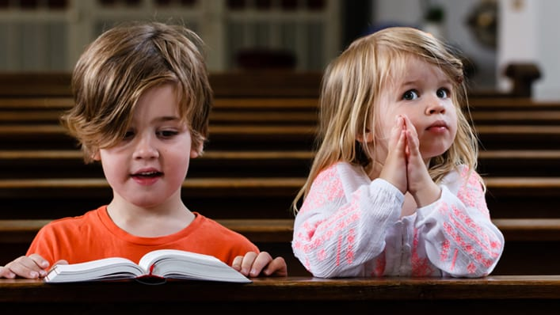
The church… just one generation away from extinction.

Slide 18
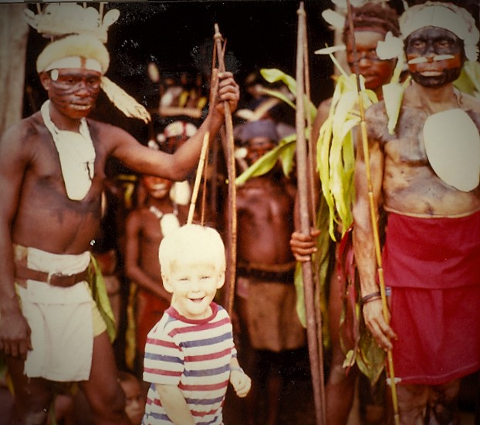

Slide 20
