Slide 1
PEOPLE-PLEASING GOD’S WAY
Romans 15:1-6

Slide 2
Romans 15
Now we who are strong ought to bear the weaknesses of those without strength and not just please ourselves. ² Each of us is to please his neighbor for his good, to his edification. ³ For even Christ did not please Himself; but as it is written, “The reproaches of those who reproached You fell on Me.”

Slide 3
Romans 15
⁴ For whatever was written in earlier times was written for our instruction, so that through perseverance and the encouragement of the Scriptures we might have hope. ⁵ Now may the
God who gives perseverance and encouragement grant you to be of the same mind with one another according to Christ Jesus, ⁶ so that with one accord you may with one voice glorify the God and Father of our Lord Jesus Christ.

Slide 4
TRUTH #1
We are all at various times “strong” and at others “weak,”
sometimes both at the same time.
Romans 15:1, 2
Now we who are strong ought to bear the weaknesses of those without strength and not just please ourselves. ² Each of us is to please his neighbor for his good, to his edification.

Slide 5
TRUTH #2
We are to use our ‘strength’ to…
Carry the weaknesses of those ‘without strength’…and
‘Please” our neighbors for their ‘good’ and ‘edification.’

Slide 6
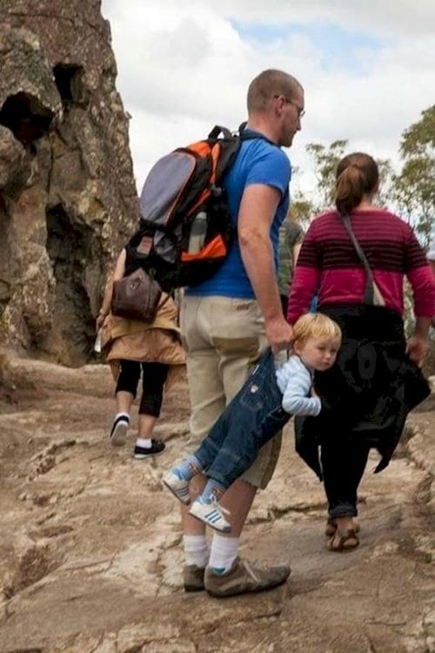

Slide 7
TRUTH #2
We are to use our ‘strength’ to…
Carry the weaknesses of those ‘without strength’…and
‘Please” our neighbors for their ‘good’ and ‘edification.’

Slide 8
TRUTH #3
We must constantly look to Jesus for HOW to properly ‘please’/encourage others.
Romans 15:3
³ For even Christ did not please Himself; but as it is written, “The reproaches of those who reproached You fell on Me.”

Slide 9
TRUTH #3
We must constantly look to Jesus for HOW to properly ‘please’/encourage others.
Psalm 69:9
“For zeal for Your house has consumed me, And the reproaches of those who reproach You have fallen on me.”

Slide 10
TRUTH #3
We must constantly look to Jesus for HOW to properly ‘please’/encourage others.
A.) Identifying with and carrying the load of others weaker than us will sometimes lead to additional criticism.

Slide 11
TRUTH #3
We must constantly look to Jesus for HOW to properly ‘please’/encourage others.
B.) Proper people-pleasing requires saturating ourselves in God’s word to obtain the necessary perseverance and encouragement that we need.
(Romans 15:4-5)

Slide 12
Romans 15
⁴ For whatever was written in earlier times was written for our instruction, so that through perseverance and the encouragement of the Scriptures we might have hope. ⁵ Now may the
God who gives perseverance and encouragement grant you to be of the same mind with one another according to Christ Jesus….

Slide 13
Romans 15
⁵ Now may the God who gives perseverance and encouragement grant you to be of the same mind with one another according to Christ Jesus, ⁶ so that with one accord you may with one voice glorify the God and Father of our Lord Jesus Christ.

