Slide 1
Bridging Differences Romans 14:1-7

Slide 3
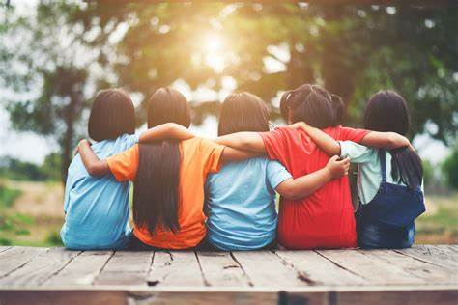
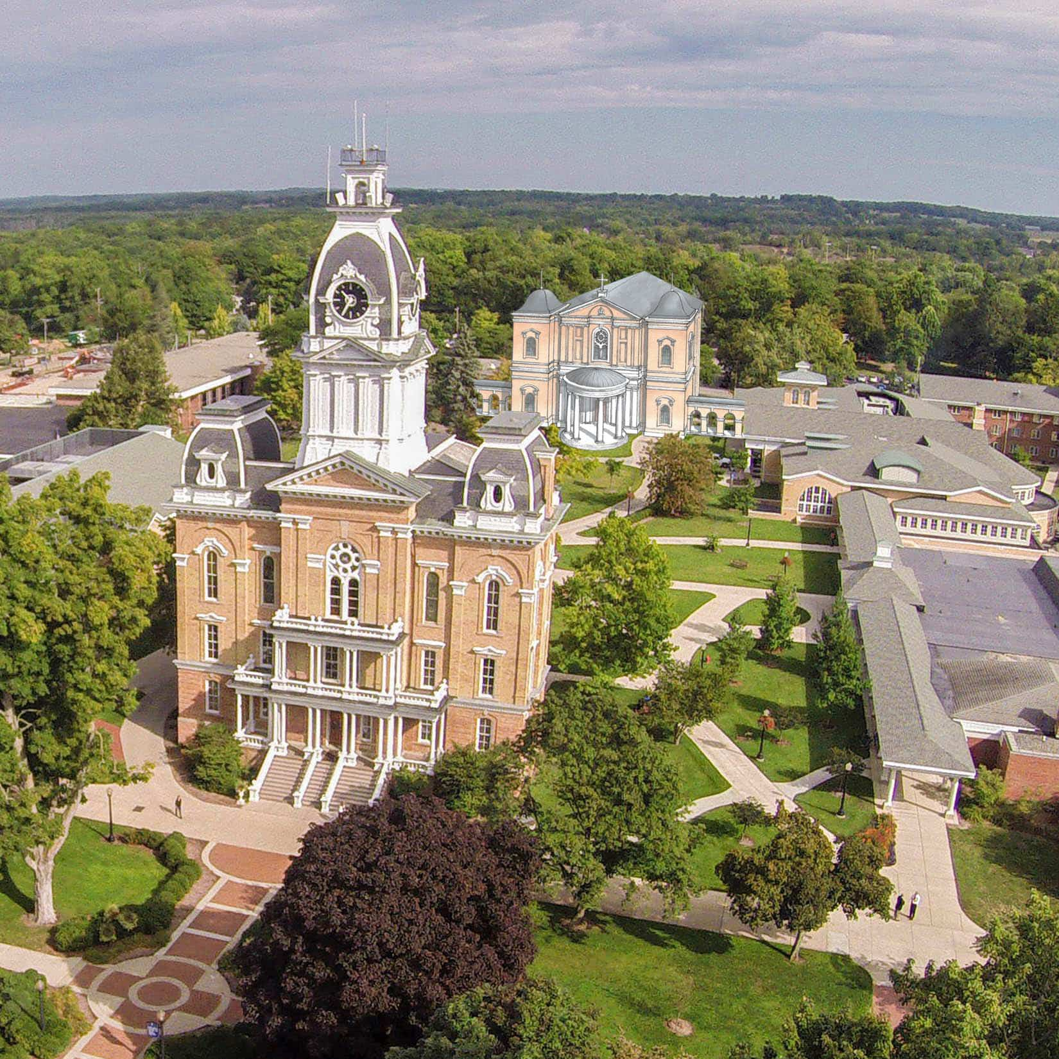

Slide 4
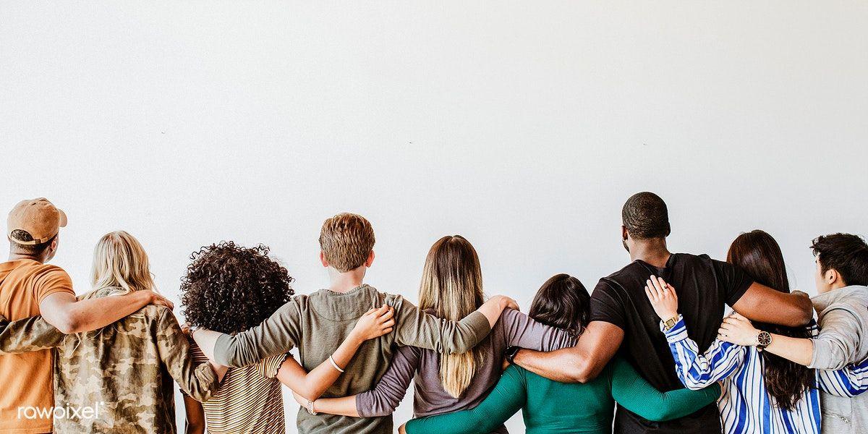
Accept One Another…. Romans 14

Slide 5
Romans 14:1 Accept the one whose faith is weak, without quarreling over disputable matters.

Slide 6
Romans 14:1 Accept the one whose faith is weak, without quarreling over disputable matters.

Slide 7
Someone whose faith is weak: --Doesn’t do something…like eat meat

Slide 8
Someone whose faith is weak: --Doesn’t do something…like eat meat. --Lives in faith & gratitude honoring God.

Slide 9
Someone whose faith is weak: --Doesn’t do something…like eat meat. --Lives in faith & gratitude honoring God. --Sees some things as common and some as special

Slide 10
Romans 14:14 “I am convinced that…nothing is unclean in itself. But if anyone regards something as unclean, then for that person it is unclean.”

Slide 11
Someone whose faith is weak: --Is not a ‘legalists’.

Slide 12
Both weaker and stronger in faith…
Seek to live by faith
Are radically God-centered
Are not self-exalting or self-indulgent

Slide 13
How should we live together when we differ about non-essential, non-absolutes—things that may not be explicitly clear from God’s word?

Slide 14
Education

Slide 15
Education
Bible translations

Slide 16
Education
Dress
Bible translations

Slide 17
Education
Dress
Entertainment
Bible translations

Slide 18
Education
Dress
Entertainment
Bible translations
Food & Drink

Slide 19
Education
Dress
Entertainment
Bible translations
Food & Drink
Holidays

Slide 20
Education
Dress
Patriotism
Entertainment
Bible translations
Food & Drink
Holidays

Slide 21
Education
Dress
Patriotism
Entertainment
Health
Bible translations
Food & Drink
Holidays

Slide 22
Education
Dress
Patriotism
Entertainment
Health
Finances
Bible translations
Food & Drink
Holidays

Slide 23
Romans 14
² One person’s faith allows them to eat anything, but another, whose faith is weak, eats only vegetables. ³ The one who eats everything must not treat with contempt the one who does not, and the one who does not eat everything must not judge the one who does, for God has accepted them. ⁴ Who are you to judge someone else’s servant? To their own master, servants stand or fall. And they will stand, for the Lord is able to make them stand.

Slide 24
Romans 14
⁵ One person considers one day more sacred than another; another considers every day alike. Each of them should be fully convinced in their own mind. ⁶Whoever regards one day as special does so to the Lord. Whoever eats meat does so to the Lord, for they give thanks to God; and whoever abstains does so to the Lord and gives thanks to God.

Slide 25
Romans 14
⁷ For none of us lives for ourselves alone,
and none of us dies for ourselves alone. ⁸ If we live, we live for the Lord; and if we die, we die for the Lord. So, whether we live or die, we belong to the Lord. ⁹ For this very reason, Christ died and returned to life so that he might be the Lord of both the dead and the living.

Slide 26
How we are to relate to others with whom we have faith differences?
no contempt, rather humility
no judgment, rather embracing acceptance

Slide 27
How we are to relate to others with whom we have faith differences?
Not quarrelsome about our differences, rather convinced in faith.

Slide 28
How we are to relate to others with whom we have faith differences?
Acknowledge that all of us are, at different times, the stronger or the weaker brother/sister.

