Slide 2
Romans 13 ⁸ Let no debt remain outstanding, except the continuing debt to love one another, for whoever loves others has fulfilled the law. ⁹ The commandments, “You shall not commit adultery,” “You shall not murder,” “You shall not steal,” “You shall not covet,” and whatever other command there may be, are summed up in this one command: “Love your neighbor as yourself.” ¹⁰ Love does no harm to a neighbor. Therefore love is the fulfillment of the law.

Slide 3
180-Degree Difference

Slide 4
Debt is not your friend; it is an enemy to be shunned.
Romans 13:8
Let no debt remain outstanding….

Slide 5
Deuteronomy 15:6 “For the Lord your God will bless you as he has promised, and you will lend to many nations but will borrow from none. You will rule over many nations but none will rule over you.”

Slide 6
Proverbs 22:7—"The rich rule over the poor, and the borrower is slave to the lender.” Romans 13:8 “Let no debt remain outstanding….”

Slide 8
2.) There is one debt that we will never be able to discharge completely: our debt to LOVE others well. Romans 13:8—Let no debt remain outstanding, except the continuing debt to love one another, for whoever loves others has fulfilled the law.

Slide 9
3.) True love is grounded in law—God’s law.

Slide 13
Law is always an expression of the nature of those who make the laws.

Slide 14
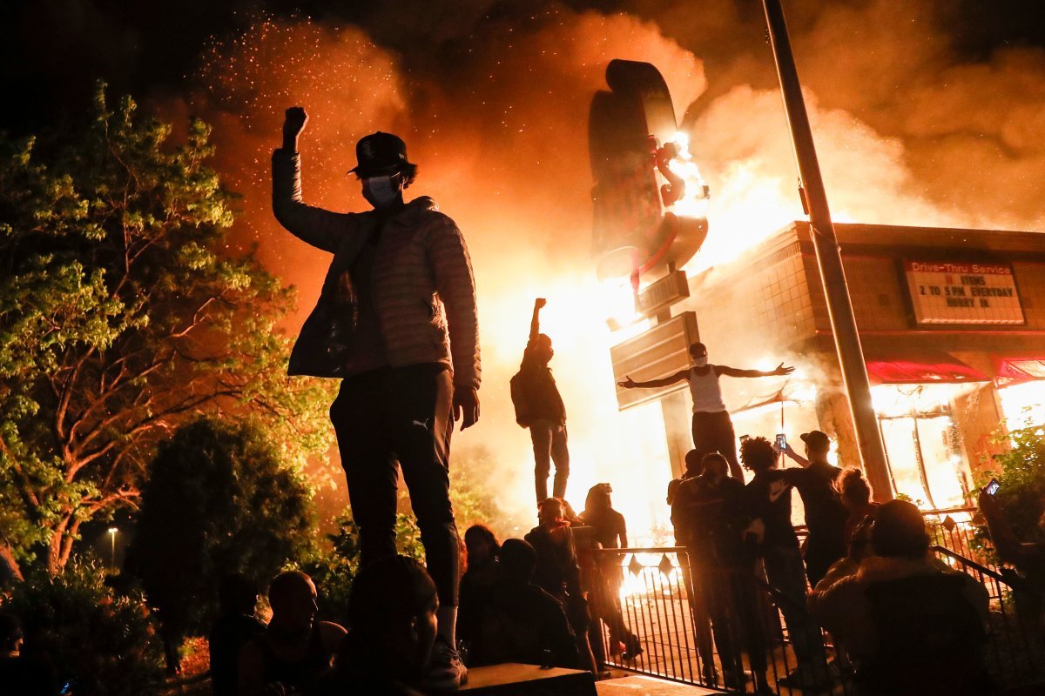

Slide 15
Romans 13 ⁹ The commandments, “You shall not commit adultery,” “You shall not murder,” “You shall not steal,” “You shall not covet,” and whatever other command there may be, are summed up in this one command: “Love your neighbor as yourself.” ¹⁰ Love does no harm to a neighbor. Therefore love is the fulfillment of the law.

Slide 16
“You shall not commit adultery.”

Slide 17
“You shall not commit adultery.”
“You shall not murder.”

Slide 18
“You shall not commit adultery.”
“You shall not murder.”
“You shall not steal.”
“You shall not covet.”

Slide 19
Romans 13:9-10
“…whatever other command there may be, are summed up in this one command: “Love your neighbor as yourself.”
¹⁰ Love does no harm to a neighbor. Therefore, love is the fulfillment of the law.”

Slide 20
Leviticus 19
“Love your neighbor as yourself.”

Slide 21
Matthew 18:15-17
¹⁵ “If your brother or sister sins, go and point out their fault, just between the two of you. If they listen to you, you have won them over. ¹⁶ But if they will not listen, take one or two others along, so that ‘every matter may be established by the testimony of two or three witnesses.’ ¹⁷ If they still refuse to listen, tell it to the church; and if they refuse to listen even to the church, treat them as you would a pagan or a tax collector.

Slide 22
Galatians 6:1
“Brothers and sisters, if someone is caught in a sin, you who live by the Spirit should restore that person gently. But watch yourselves, or you also may be tempted.”

Slide 23
Leviticus 19
¹⁵ ‘You shall do no injustice in judgment. You shall not be partial to the poor, nor honor the person of the mighty. In righteousness you shall judge your neighbor. ¹⁶ You shall not go about as a
talebearer among your people; nor shall you take a stand against the life of your neighbor: I am the Lord.

Slide 24
Leviticus 19
¹⁷ ‘You shall not hate your brother in your heart. You shall surely rebuke your neighbor, and not bear sin because of him. ¹⁸ You shall not take vengeance, nor bear any grudge against the children of your people, but you shall love your neighbor as yourself: I am the Lord.

Slide 25
What constitutes a ‘need to know’?
Doubt about the wisdom or integrity of your current spiritual leadership.
Personal relationship with the disfellowshipped
Questions about how to relate to them going forward.
???

